Slide 1
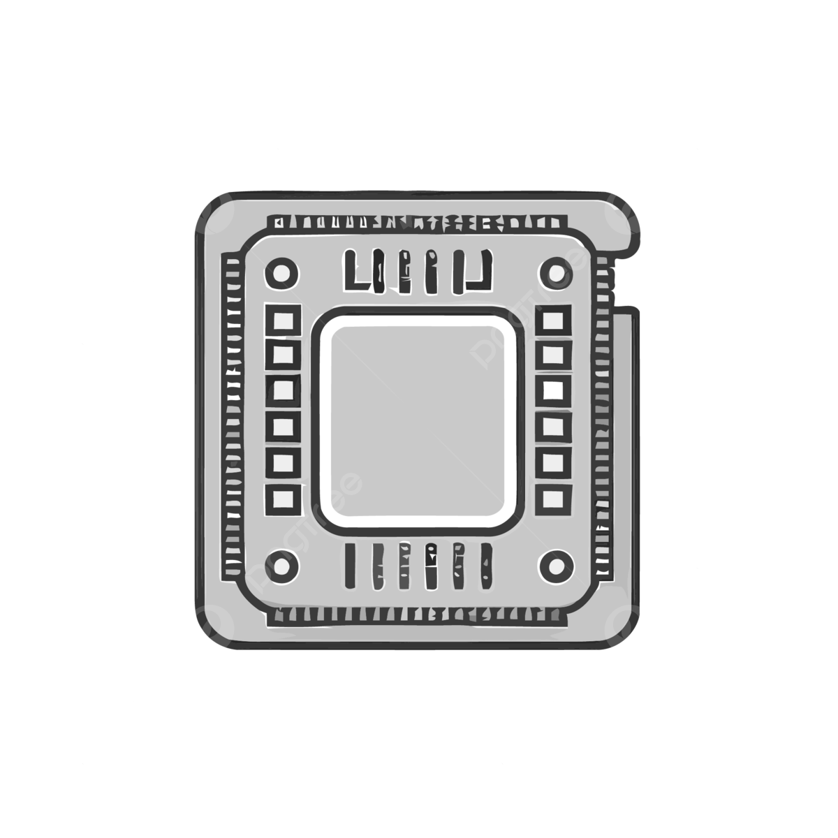
Semiconductor & Solid-State Device Manufacturing Industry
Joo Hyoung (Brian) Park, Mohammed A., Eric Lin, Shazan Khan, Aoyin Yan

Slide 2
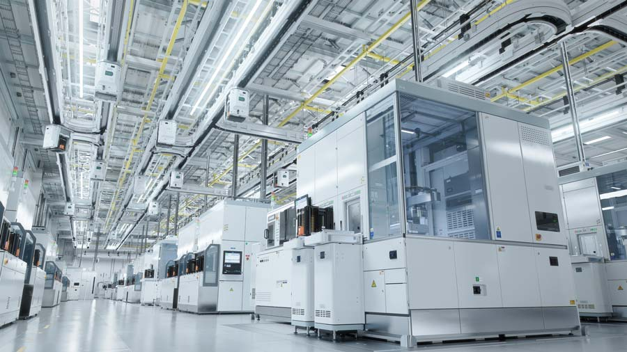

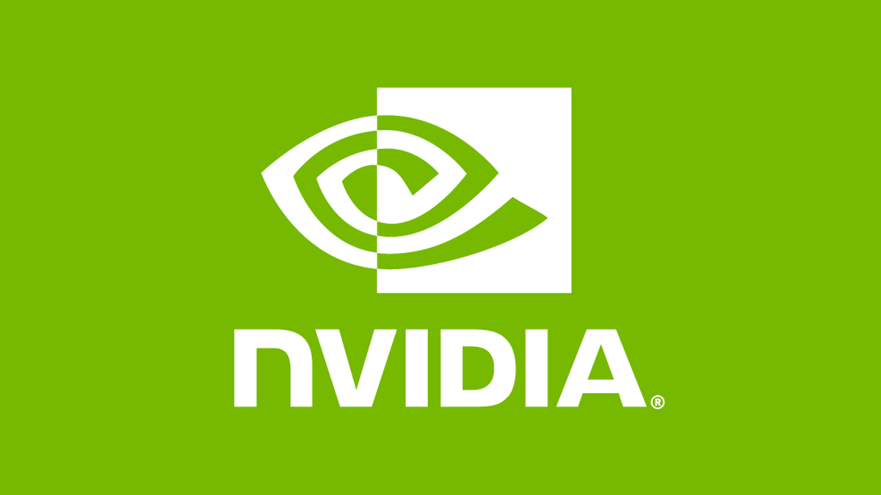

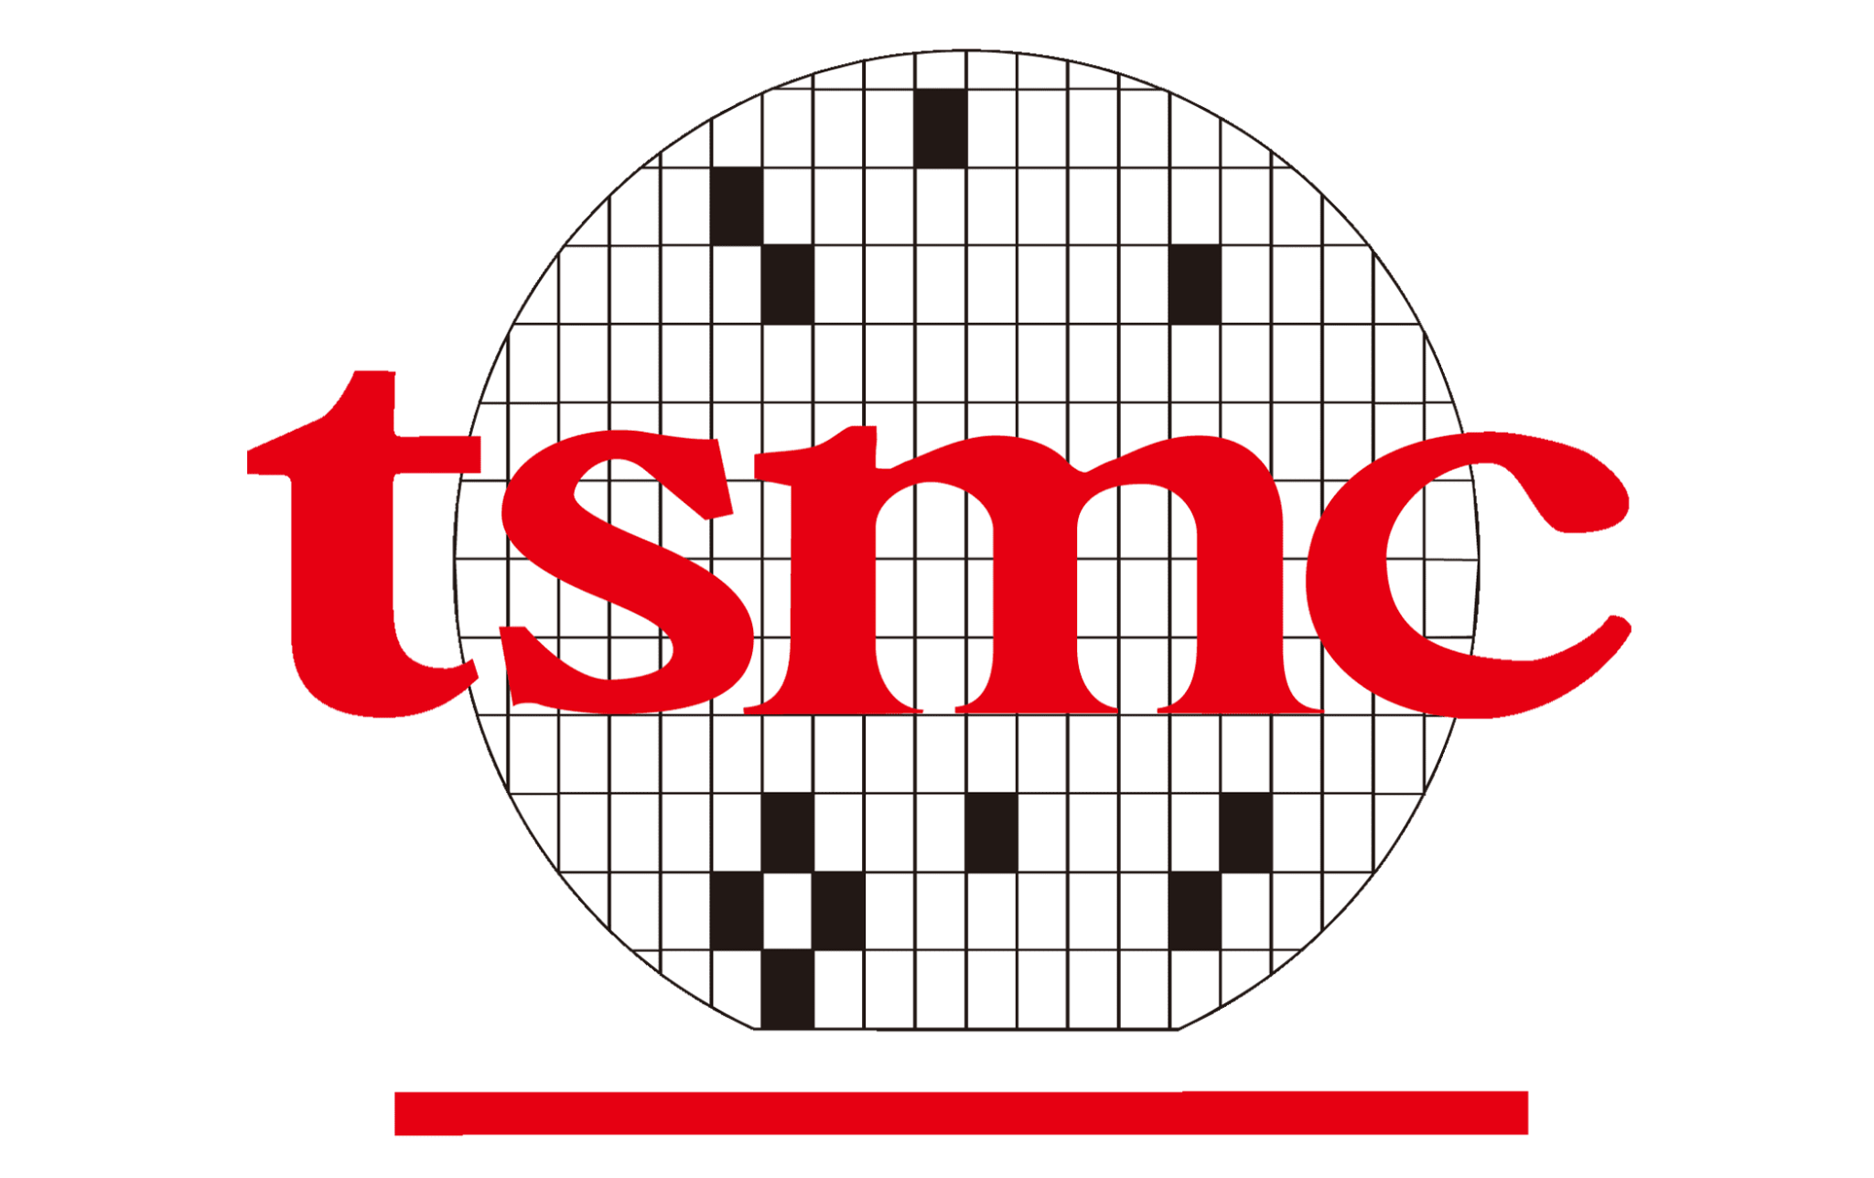
Industry Background
SIC Code: 3674
Description: Establishments primarily engaged in manufacturing semiconductors and related solid-state devices.

Slide 3
Industry Background: Notable Companies
10 Companies with the largest Market Cap for this industry:
10 Companies with the smallest Market Cap for this industry:
NVIDIA
Taiwan Semiconductors
Broadcom
Intel Corp.
Advanced Micro Devices
Texas Instruments Inc.
Qualcomm Inc.
Analog Devices Inc.
Micron Technology Inc.
Marvell Technology Inc.
Sealsq Corp
Hei Inc.
Dynex Power Inc.
Solitron Devices Inc.
Logicvision Inc.
ISC8 Inc.
Jet Neko Inc.
Dialog Semiconductor PLC.
Innovex Inc.
Tvia Inc.

Slide 4
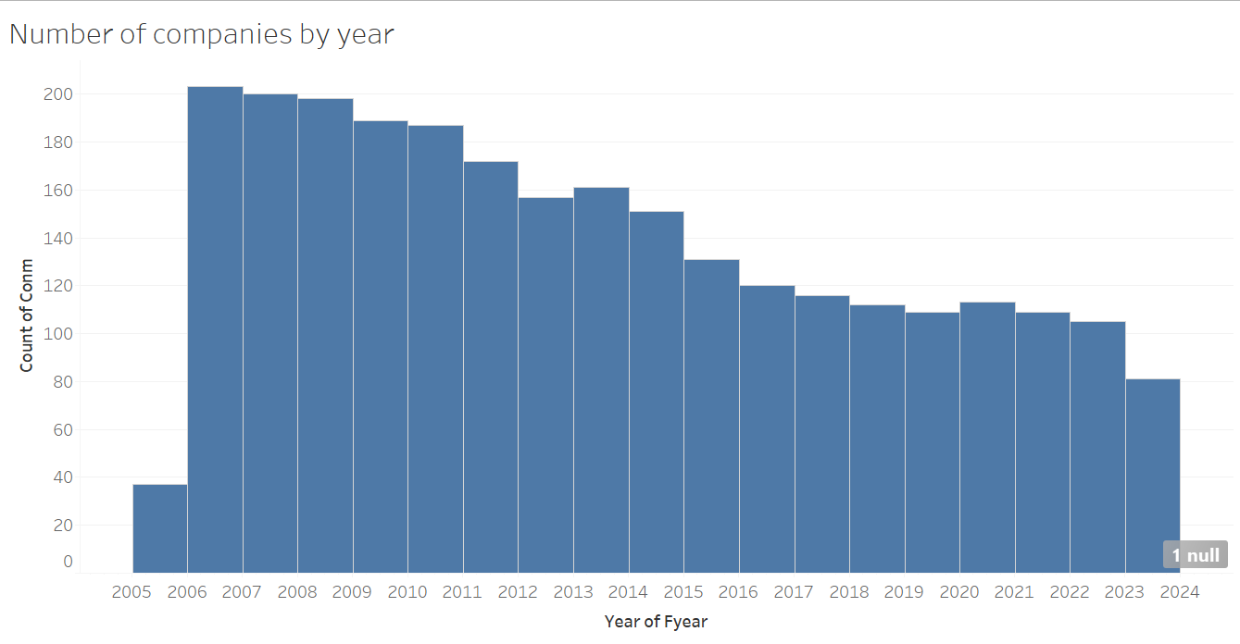
Industry Background: Companies over Time
Number of firms booms in 2006, then capitulates to less than half of the number of firms by 2023
Decrease in number of firms around the 2008 Housing Crisis are minimal
Industry increases in number of firms during the first year of the pandemic.

Slide 5
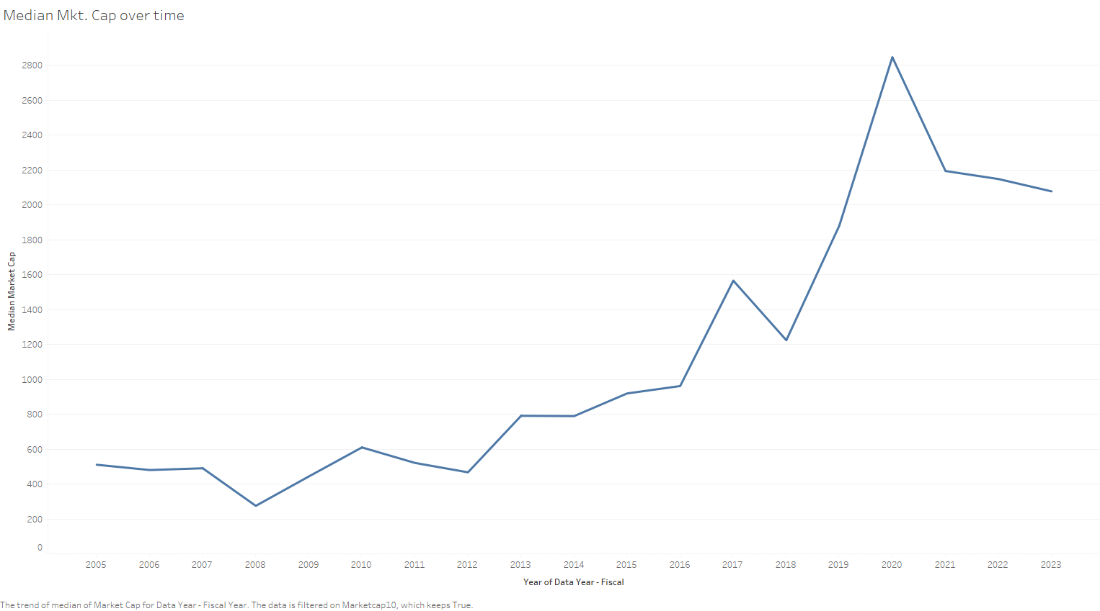
Industry Background: Market Cap over Time
Exponential increase in Market Cap from the late 2010’s to end of 2020.
Decrease in Market Cap during the 2008 recession. Small dip in comparison to the late 2010’s boom.

Slide 6
Industry Background: Areas of Concern
Common words found in large companies’ 2023 10-K Item 1A:
Products
Business
Customers
Operations
Common words found in small companies’ 2023 10-K Item 1A:
Stock
Products
Business
Common

Slide 7

Accounting

Slide 8
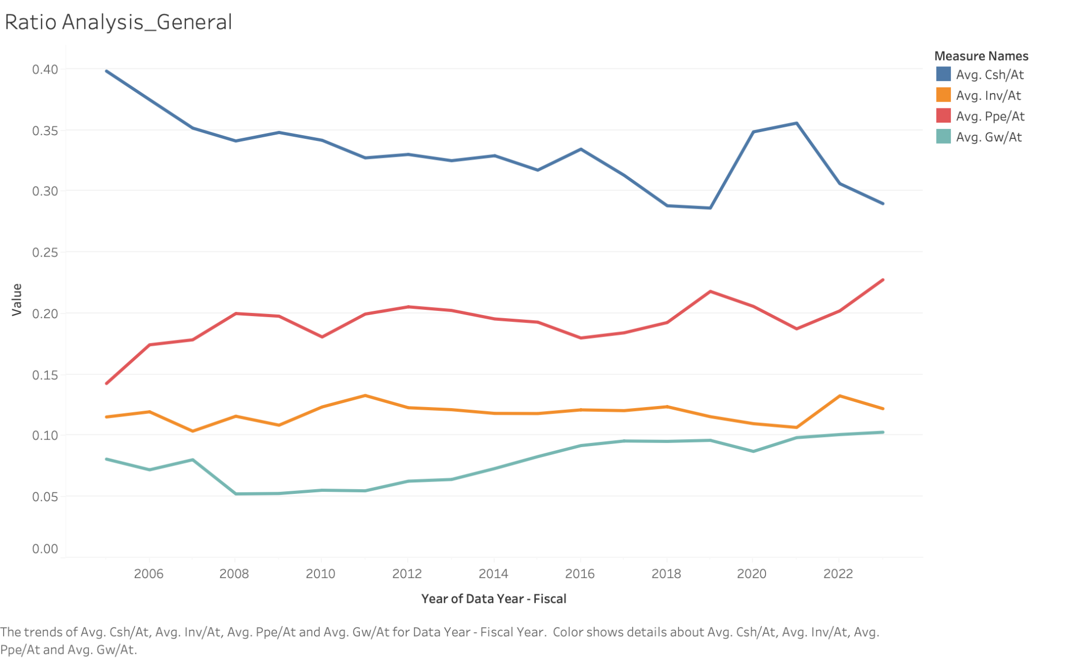
Accounting Aspect
Cash made up the most significant portion of the balance sheet.
The semiconductor industry is R&D-heavy, commodity-based, and only moderately reliant on PPE and marketing investment.
Cash is important to them!

Slide 9
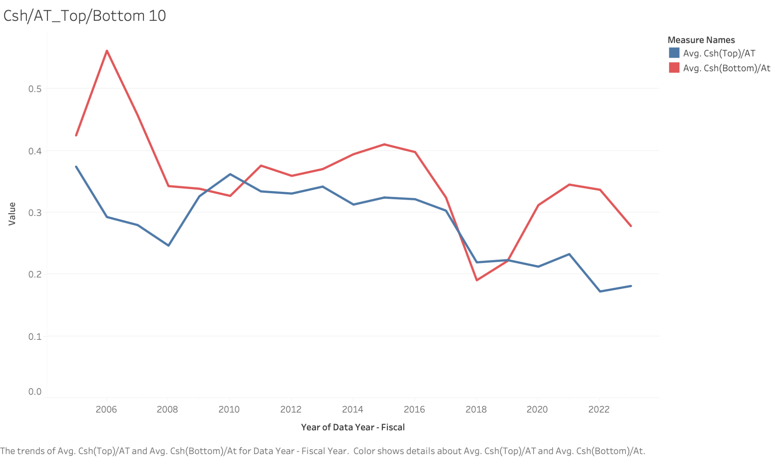
Accounting Aspect
Smaller firms’ cash-to-asset ratio tends to be slightly higher than that of large firms.
Larger firms are not just large only because they have larger cash flows - other asset items grew at the same time, eventually watering down the cash ratio.

Slide 10
Accounting Aspect - Profitability and Financial Overview
The cash ratio significantly changed during the 2008 Housing Crisis. However, the pandemic did not really affect anything.
This indicates that the semiconductor industry relies heavily on the functional operation of a healthy financial system, not on market demand.
ROA also supports this insight. The industry's mean ROA is -0.007, which indicates pessimistic profitability regarding its heavy cash proportion. However, the median is 0.05, which looks better than the industry average. This discrepancy indicates that the laggard firms fall behind.

Slide 11
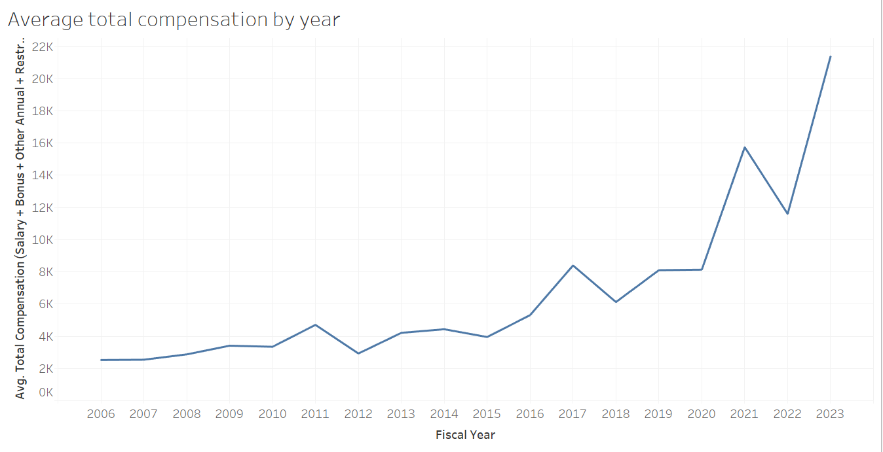
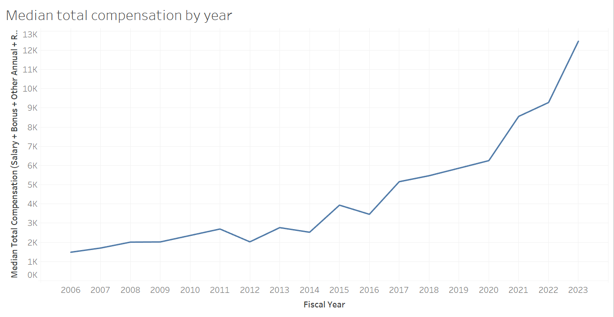
Average vs Median compensation change
Both Average and Median follow a similar pattern

Slide 12
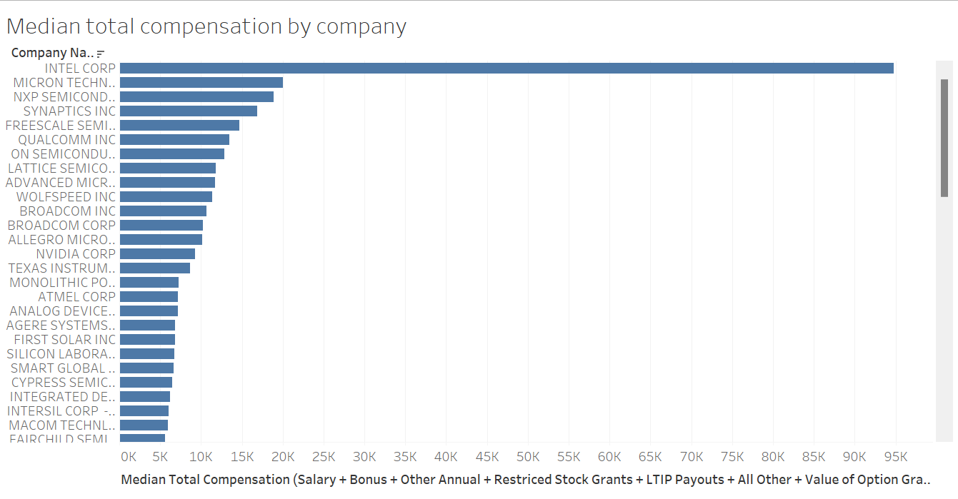
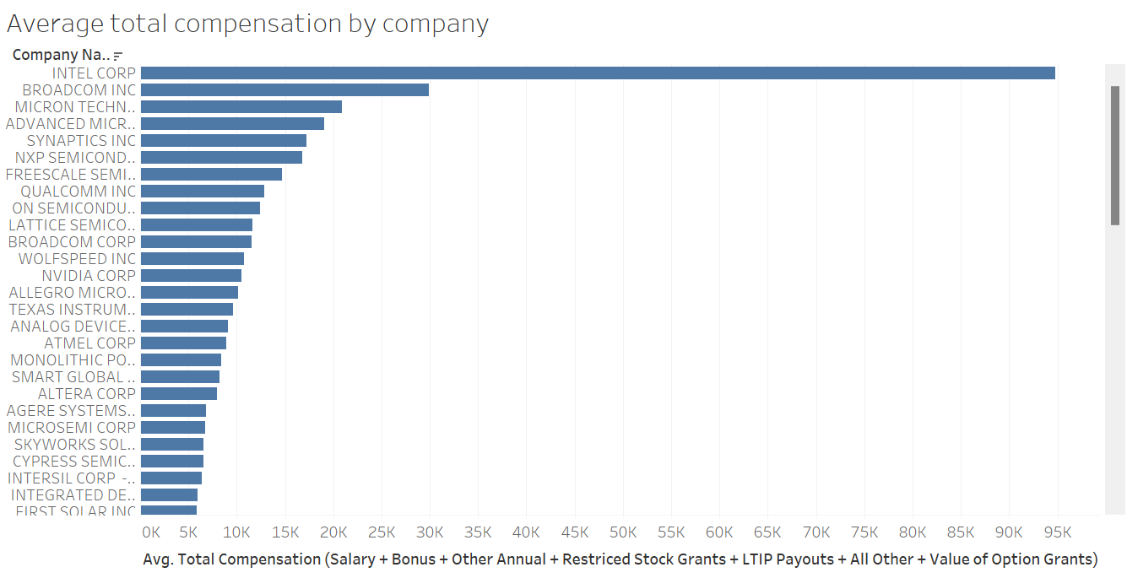
Companies affecting Executive Compensation
Intel
Micron Technologies
NXP Semiconductors
Intel
Broadcom Inc
Micron Technologies
Notes:
Intel is always the highest company affecting compensation.
Companies affecting median and average differ because some companies have seen faster growth than others. Also some companies have much higher pay ratios as of late, which will affect their average pay more than their median pay.

Slide 13
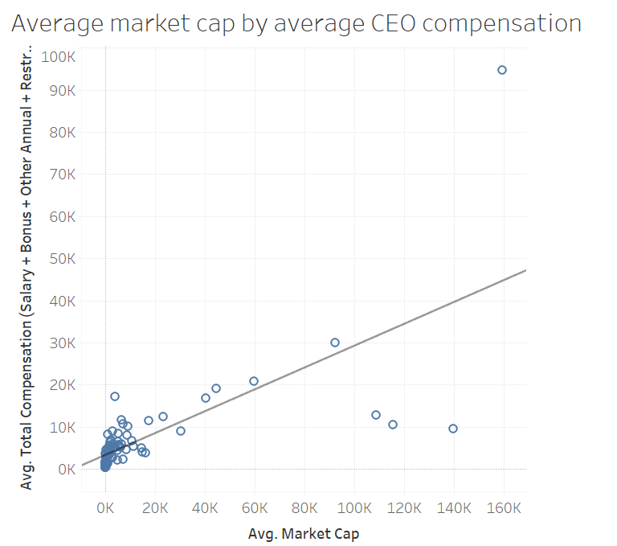
CEO Pay by Company Size
~ 0.26 * Average Market Cap + 3444.09
~ 0.12 * Average Market Cap + 4365.94 (No Intel)
Intel has the largest effect on the trend line

Slide 14
Executive to Employee Pay Ratio
Intel
Broadcom
Nvidia
AMD
Texas Instruments
Smart Global Holdings
Ultra Clean Holdings
MaxLinear Inc
Mercury Systems Inc
Ambarella
x256
Outlier
x75

Slide 15

Textual Analysis

Slide 16
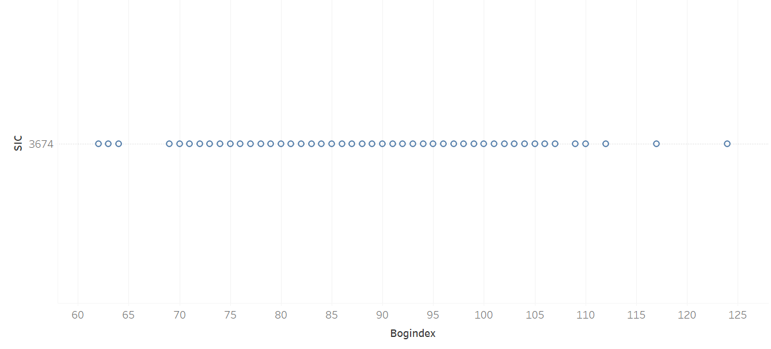
Tableau Analysis: Bog Index for Our Industry
Each bubble represents a firm within the Semiconductor Manufacturing industry and its respective Bog Index. There are few outliers, and the majority are packed in the middle.

Slide 17
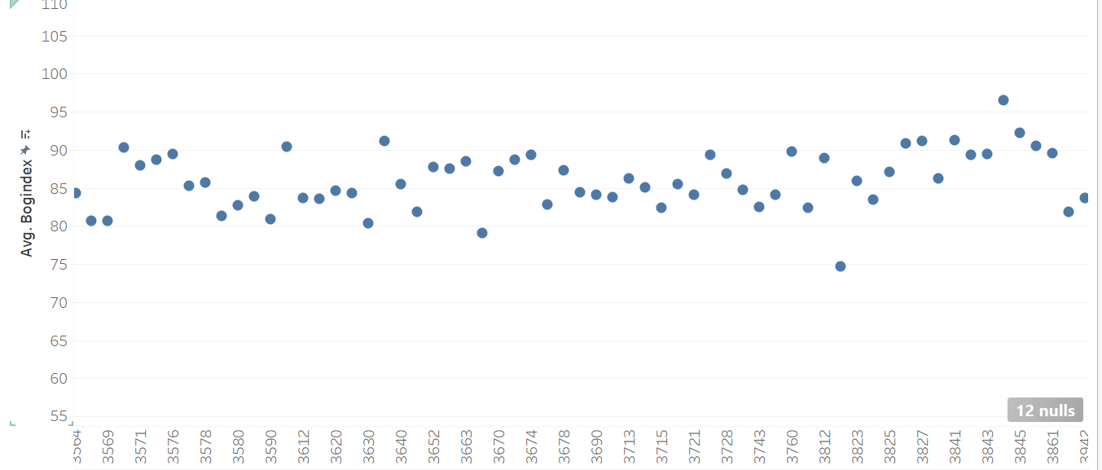
Average Bog Index by Industry fluctuates within a range
Each bubble represents a specific industry (By SIC code) and its respective average bog Index. Red highlighted bubble is the Semiconductor Industry.

Slide 18

Financials

Slide 19
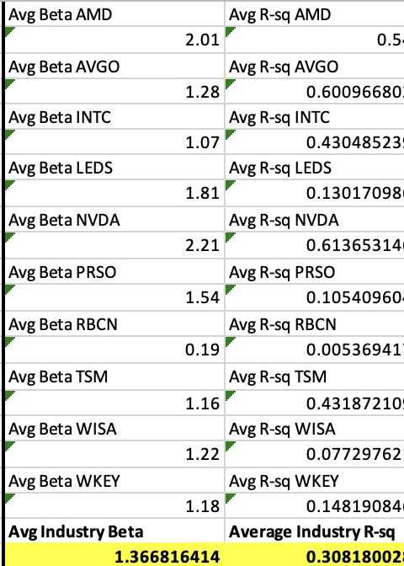
We assessed industry average betas and R squared.
Industry average beta: grouped by the largest 5 and smallest 5 companies.
With rare exceptions, average beta is > than the S&P 500 standard of 1.00.
NVIDIA and AMD, both large caps, are particularly volatile with betas above 2.

Slide 20
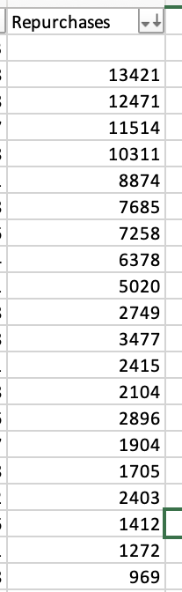
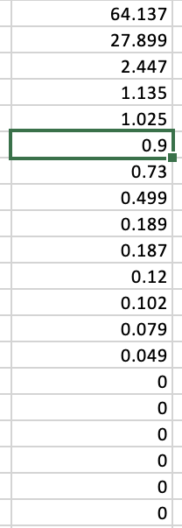
We sorted repurchases by the biggest 5 and smallest 5.
Left: Repurchases of shares sorted by largest 5 companies in the industry, dominated by INTC and NVDA
Right: Repurchases of shares sorted by smallest 5 companies in the industry. Considerably less repurchase activity

Slide 21
Event Studies

Slide 22
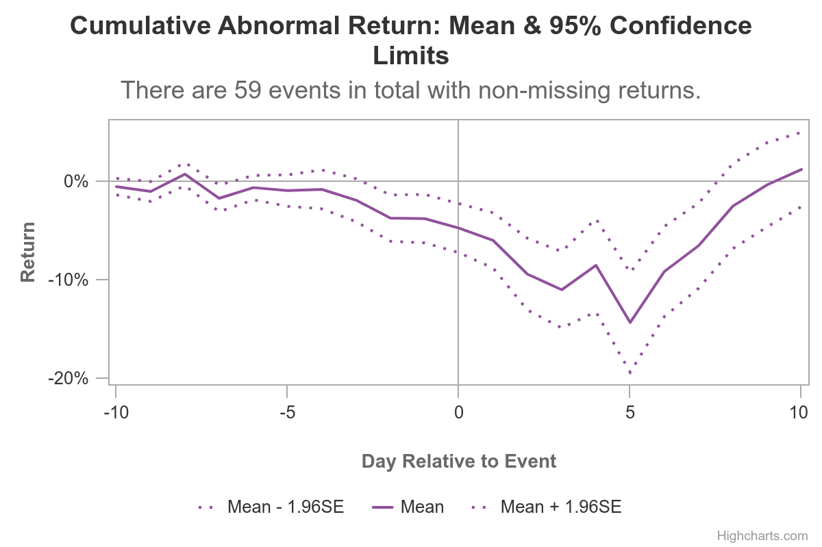
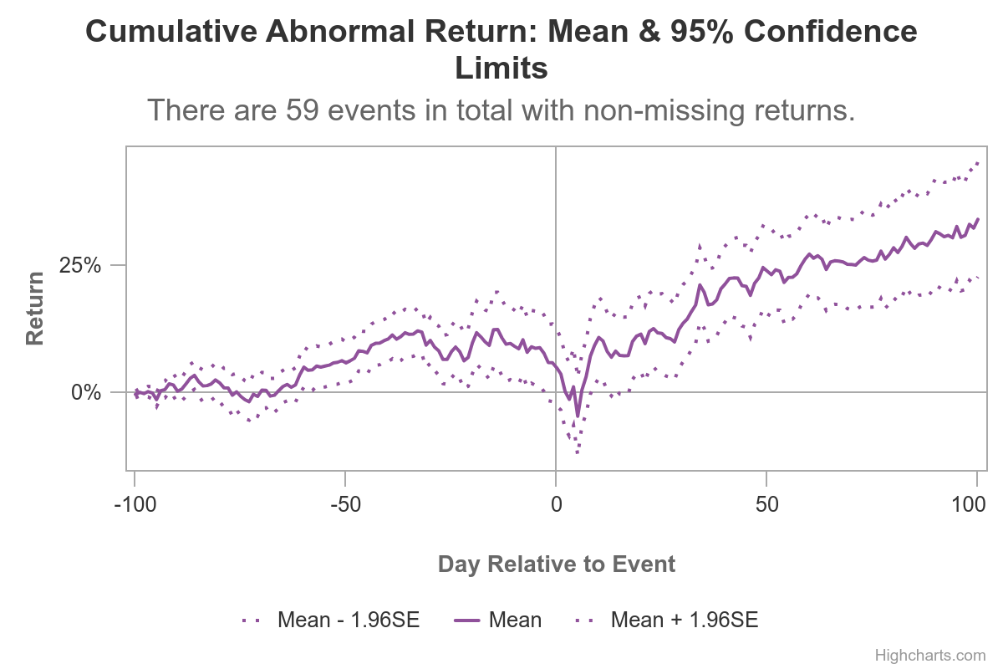
Covid-19 Effect
Panic
Demand Increase
Supply Decrease

Slide 23
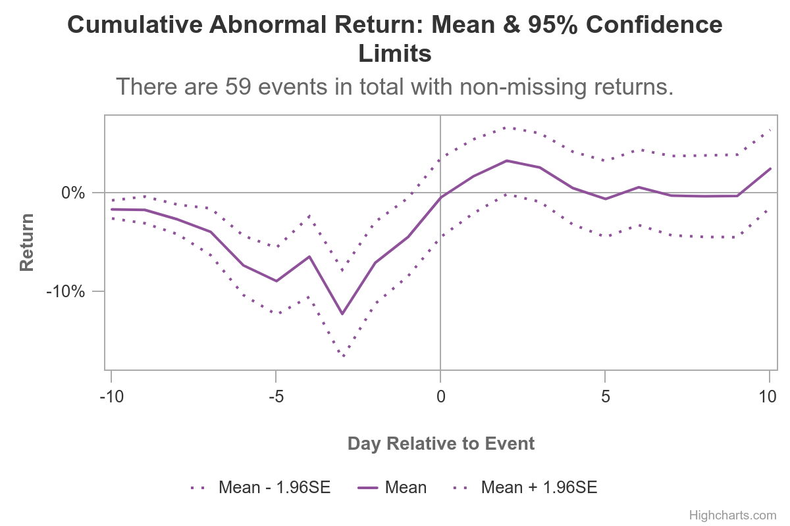
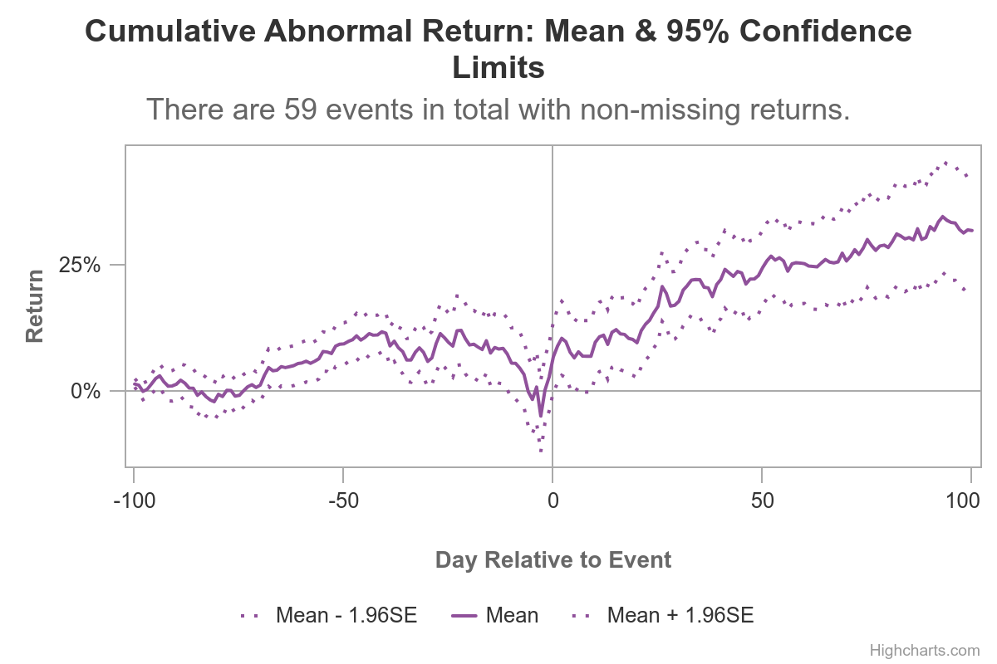
Aid Package Effect
Notes:
While the aid package was relevant in reducing the panic in general public, we still attribute this increase in returns to the increase in demand and decrease in supply.

Slide 24

ESG Reporting

Slide 25
ESG Reporting: Variables
Strength | Concern
Environment Other Strength | Hazardous Waste
Clean Energy | Water Management
Pollution Prevention | Waste Management
Human Capital Management | Waste Management - Electronic Waste
Health & Safety Strength | Health & Safety Concern
Emp. Relations Other Strength | Emp. Relations Other Concerns
Human Capital - Labor | Board Diversity
Diversity Other Strength | Employment of Underrepresented Groups
Gay & Lesbian Policies | Board of Directors
Product Safety - Chemical Safety | Transparency Concern
Product Safety - Privacy and Data Security
Raw Material Sourcing
Corruption & Political Stability
Transparency Strength
Ownership Strength
Public Policy Strength
Areas of Materiality:
Environment
GHG Emissions
Energy Management
Waste & Wastewater Management
Waste & Hazardous materials Management
Human Capital
Employee Health & Safety
Employee Engagement, Diversity & Inclusion
Business Model & Innovation
Product Design & Lifecycle Management
Materials Sourcing & Efficiency
Leadership & Governance
Competitive Behavior

Slide 26
ESG Reporting
Average KLD Score:
Average KLD Score:
Intel
Broadcom
Nvidia
AMD
Texas Instruments
Smart Global Holdings
Ultra Clean Holdings
MaxLinear Inc
Mercury Systems Inc
Ambarella
3
0

Slide 27
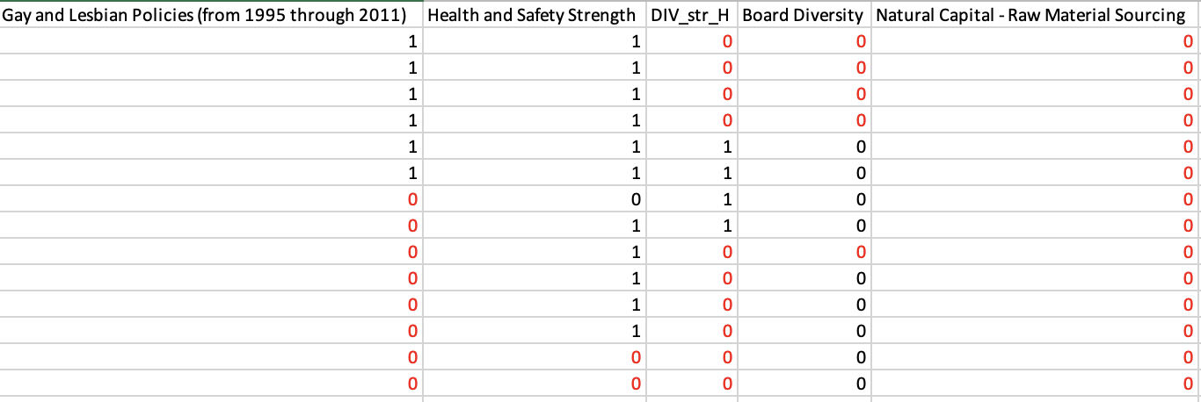
ESG Reporting: Concerns with Analysis
Difficult to extract data
Majority of columns had to be backfilled with artificial zeros
Difficult to find small companies with data at all

Slide 28
Conclusions
Resilient:
The industry has showed that it stays relatively resistant to macroeconomic downturns
Top-Heavy:
Capital, demand, market capitalization are all heavily skewed towards the top
Optimistic Future:
For the firms at the top, return on invested capital look to be bullish with further breakthroughs in technology
1
2
3

